Slide 1

Machine Learning
K-nearest Neighbor
Muhammad Affan Alim

Slide 2
Nearest-Neighbor Classifiers
Requires three things
  The set of stored records
  Distance Metric to compute distance between records
  The value of k, the number of nearest neighbors to retrieve
To classify an unknown record:
  Compute distance to other training records
  Identify k nearest neighbors
  Use class labels of nearest neighbors to determine the class label of unknown record (e.g., by taking majority vote)

Slide 3
Definition of Nearest Neighbor
K-nearest neighbors of a record x are data points that have the k smallest distance to x

Slide 4
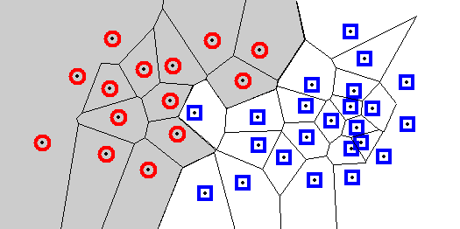
Voronoi Diagrams for NN-Classifiers
Each cell contains one sample, and every location within the cell is closer to that sample than to any other sample.
A Voronoi diagram divides the space into such cells.
Every query point will be assigned the classification of the sample within that cell. The decision boundary separates the class regions based on the 1-NN decision rule.
Knowledge of this boundary is sufficient to classify new points.
Remarks: Voronoi diagrams can be computed in lower dimensional spaces; in feasible for higher dimensional spaced. They also represent models for clusters that have been generate by representative-based clustering algorithms.

Slide 5
Instance based learning
In machine learning, instance-based learning is a family of learning algorithms that, instead of performing explicit generalization, compares new problem instances with instances seen in training, which have been stored in memory.

Slide 6
Machine Learning
Examples of instance-based learning algorithm are the
k-nearest neighbor algorithm, kernel machines and RBF
networks.
These store (a subset of) their training set; when predicting a value/class for a new instance, they compute distances or similarities between this instance and the training instances to make a decision

Slide 7
Instance based learning
Instance based learning (k-NN) is a “lazy” learning algorithm – does virtually nothing at training time
• but classification/prediction time can be costly when the training set is large

Slide 8
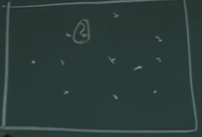
How it works
Suppose this is the instance phase and you have different points in the instance phase

Slide 9
How it works
For each point, you have the corresponding x value and the y value
In regression case, when you are given a new instance, you find what the closest instance in terms of the x value and guess the y value of new instance as the y value of closet instance.
In classification case, the new instance will belong the most similar instance.

Slide 10
How to find the similarity
Euclidean distance is used for similarity in K-nearest neighbor (KNN) algorithm
Some other distance or metric like cosine, mutual information and other algorithms are used depending on the type of data

Slide 11
K nearest neighbor algorithm works as follows
As we seen earlier that learning algorithms have two phase
- Training phase
- Testing phase
In KNN training phase, a model is not learnt (recognize as lazy algorithm).
Just collect the training features in main memory

Slide 12
K nearest neighbor algorithm works as follows
For test instance, only the x value x_{t} is given and predict the corresponding y_{t}
Suppose that k training examples (x₁, y₁), (x₂, y₂), ... ,(x_{k}, y_{k})
Which is similar or closest of x_{t} ?

Slide 13
K nearest neighbor algorithm works as follows
There are two types of outputs
  Classification : Predict the majority class from {y₁, y₂, ... , y_{n}}
  Regression : Predict the average of among the y_{i}’s
  Improvement
  - Weighting examples from the neighborhood
  - Measure "closeness"
  - Finding "close" examples in a large training set quickly

Slide 14
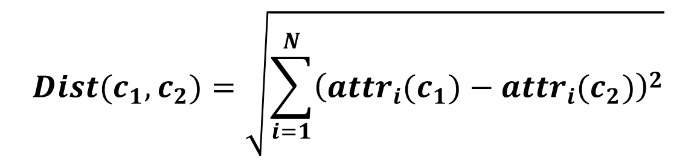
K nearest neighbor algorithm works as follows
The formula of the KNN by Euclidean distance
Prediction/classification of test image
$$Dist(c_{1},c_{2})=\sqrt{\sum_{i=1}^{N}{{\left(attr_{i}(c_{1})−attr_{i}(c_{2})\right)}^{2}}}$$

Slide 15
K nearest neighbor algorithm works as follows
Equal weights to all attributes ?
- only if the scale of the attributes are similar
- Scale attributes to equal range and equal variance
- classes are spherical (no attributes has more information
to others)

Slide 16
K nearest neighbor algorithm works as follows
If the attributes have not the properties of equal weight then how to overcome the problem
- use the larger K
- use the weighted distance function

